Slide 1

Agile 7-DB Systel Japanese
Neeraj Vohra

Slide 2
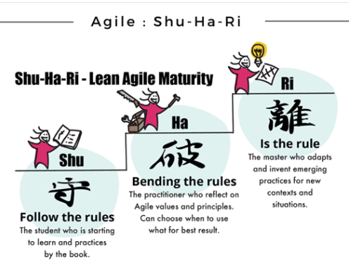
Shu Ha Ri?
Shu-Ha-Ri is a way of thinking about how you learn a technique. The description of Shu Ha Ri comes from the Japanese martial arts’ Kata (AKA forms)

Slide 3
Shu Ha Ri?
Shu: In this beginning stage students follow the teachings of one master precisely. They concentrate on how to do the task, without worrying too much about the underlying theory. If there are multiple variations on how to do the task, they concentrate on just the one way their master teaches them.
A team starts with Shu. During this stage, team needs coaching, mentoring, and guidance to know what rules to follow. It practices Scrum by the book, follow the roles, the meetings/ceremonies, and the artifacts. Shu: Follow the rule. Attributes: mimics the practices, learn the process basics.
Ha: At this point students begin to branch out. With the basic practices working they now start to learn the underlying principles and theory behind the technique. They also start learning from other masters and integrates that learning into his practice.
A team enters the Ha stage only after it has shown its ability to use Scrum as it was intended and has achieved a deep understanding of the spirit of Scrum, core values and 12 guiding principles. The team moves beyond a collection of skilled individuals toward thinking and acting as one unit. The team as a whole develop its own personality, staying consistent with practices, values and working through failures using retrospectives and adapt. Ha: break the rules. Attributes: learning, growing, flexible

Slide 4
Shu Ha Ri?
Ri: Now the students aren't learning from other people, but from their own practice. They create their own approaches and adapts what they've learned to their own particular circumstances.
Ri is the highest-level team may reach and output of the team is greater than the sum of the work of the individuals on the team. In Ri level, the team is innovative, and they experiment with new ideas and concepts, share the results, and make a recommendation as to how to proceed. Here the team is more sustainable and predictable, with a clear focus on improved throughput. Ri: be the rule. Attributes: efficient, precise, confident, self-managing, transparent, trusted, and proven.
Like any self-disciplined skills of martial arts, the transition to next higher level depends on team members’ dedication to learn, inspect and adapt. However, at each level, team should operate few sprints in learning what to do and then some more sprints to do it better in consistent way.

Slide 5
Shu Ha Ri?
Benefits for pursuing higher Stage (Ri – Level 3)
Hyper-productivity – the team will be able to produce quality software at an amazing rate enabling a faster time to market and lower IT costs.
Extremely efficient – the team will efficiently estimate, plan, execute and report progress and impediments.
Higher quality – fewer defects will result from their work.
Predictable and consistent – their velocity is well known and consistent, allowing for greater confidence in future delivery estimates.
Improved morale – members want to work together more for the betterment of the team.
Improved stakeholder satisfaction – business sponsors working with RI teams will enjoy working with the team.

Slide 6
Shu Ha Ri?
Characteristics of Best Performing Agile Team.
A cross-functional, self-organizing agile team exhibits following behaviors to create a successful team and product.
respect - between individuals and teams, also from leadership and the business regarding velocity
transparency - makes successes, issues, risks, and failures visible
commitment - to complete the work that was committed to
simplicity - in process, in tools, in our designs, and in what is built
truth - in every communication
focus - on the critical path and in resolving issues with urgency
trust - between individuals and teams, between business and technology,
feedback - via demonstrations and retrospectives
courage - to do/say what is right especially when that will be uncomfortable for those involved

Slide 7
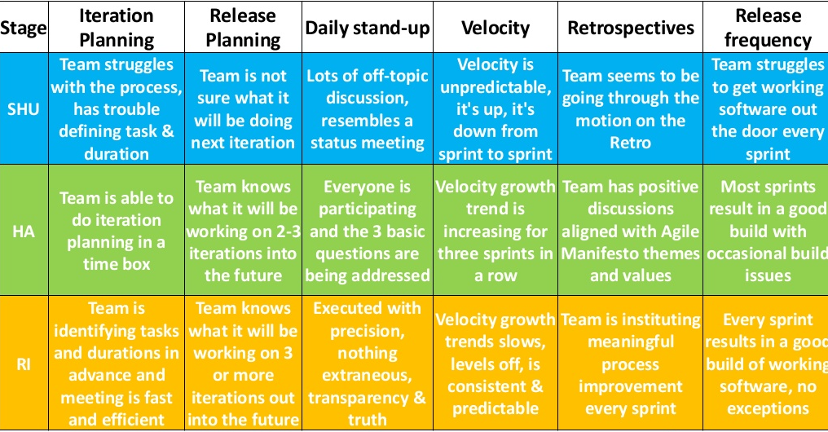
Shu Ha Ri?

Slide 8
Poka-yoke
Humans make mistakes, and these mistakes can cause defective products. Poka-Yoke, also known as mistake-proofing, is a technique for avoiding simple human errors at work.
'Poka’ means 'Mistakes' and 'Yoke' means 'Avoid'. Its objective is to achieve Zero defects.
'Poka-yoke' is a quality assurance technique. the aim of poka-yoke is to eliminate defects in a product by preventing or correcting mistakes as early possible.
When a mistake reaches the customer, it becomes a defect. Poka yoke aims to prevent defects by catching, correcting, and eliminating mistakes at the source.
Immediate corrective or preventative actions.
You have a step on brake or clutch before you start your 🚗.

Slide 9
The six principles of poka-yoke
Elimination – the most preferable solution. It involves redesigning a product or process so that a particular step is no longer necessary.
Prevention – or engineering a product or service so that it is virtually impossible for an individual to make a mistake.
Replacement – can a more reliable process be substituted in to lessen the chances of an error occurring?
Facilitation – or the adoption of techniques to make a task easier to perform. This may involve combining certain steps.
Detection – or identifying an error before further process steps are undertaken. This allows the error to be rectified without further damage to equipment or personnel.
Mitigation – the least preferable solution. Here, the aim is to minimize the effects of errors without necessarily solving them.

Slide 10
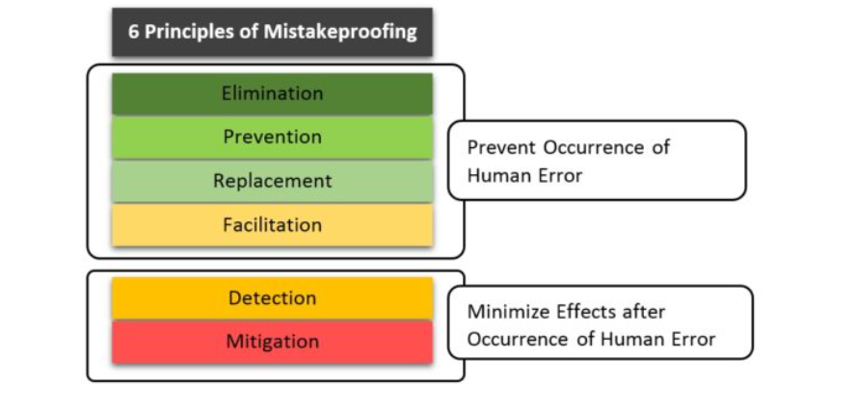
The six principles of poka-yoke

Slide 11
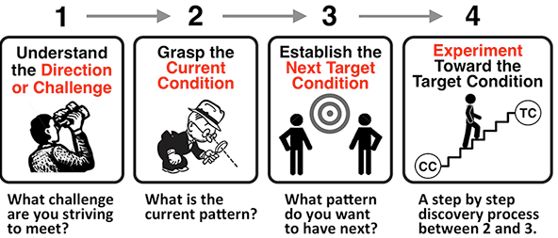
kata
Kata is structured practice for consistent improvement.
The form and order of doing things. Instead of rushing to fix a problem when you have little to no-insight, kata in courage think before doing.

Slide 12
Andon cord
Toyota developed the andon cord method in lean manufacturing whereby if a defect were to be detected on the production line, an employee can pull a cord or push a button to stop production so the defect can be addressed immediately. The aim was to give the worker the ability, and moreover the empowerment, to stop production when a defect is found, and immediately call for assistance.
Applying the andon cord to Agile
The principle is quite simple: if an issue occurs when testing, the tester has the empowerment to communicate the defect to the developer and the defect becomes the focus of attention until it’s rectified.

Slide 13
Sashimi
Sashimi is a Japanese word that means a pierced body. Basically, it is a Japanese dish that consists of fresh meat or fish, sliced into thin pieces. Each piece is similar in taste when compared with the other pieces.
Sashimi in scrum methodology means every phase of the software development cycle in a sprint which includes requirement analysis, planning & design, development, testing, documentation is complete or not and the product is ready to be displayed, etc.
This term is analogous to “done”; it is used to define the specific task when it is completed. Vertical slice of part of system functionality

Slide 14
Gemba Walk
Gemba (現場, also spelt less commonly as genba) is a japanese term meaning "the real place." Japanese police could refer to a crime scene as gemba, and TV reporters often refer to themselves as reporting live from gemba.
Quite simply, for rock bands, the “Gemba” is the recording studio. For Formula 1 teams, the “Gemba” is wherever the car is. For manufacturers, it’s the factory floor and so on. In other words, it is where the real work happens, so you can observe and analyze it.
What is a Gemba Walk?
In lean manufacturing, the whole point of gemba is that problems in a business process or production line are often easily visible, and the best improvement come from going to 'the real place', where leaders can see the state of the process for themselves.
"Go see, ask why, show respect"

Slide 15
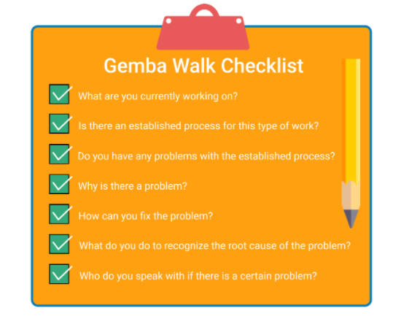
Gemba Walk
Over the course of a Gemba Walk, leaders, managers and supervisors are expected to simply observe and understand process. As part of the Kaizen methodology, it is also supposed to encourage greater communication, transparency and trust between the lower-level of employees and leadership. For this reason, it is not appropriate to use a Gemba walk to point out employee flaws or enforce policy - this runs the risk of employees putting up barriers to leadership or closing off altogether.

Slide 16
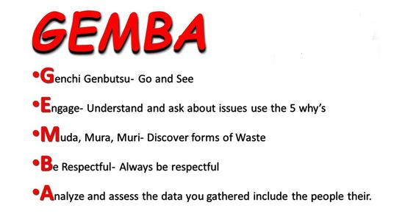
Gemba

Slide 17
Genchi Genbutsu
Genchi Genbutsu (現地現物) literally translates "real location, real thing” and it is a key principle of the Toyota Production System. The principle is sometimes referred to as "go and see." It suggests that in order to truly understand a situation one needs to observe what is happening at the site where work actually takes place: the genba (現場). One definition is that it is "collecting facts and data at the actual site of the work or problem.
Genchi-Genbutsu is the Japanese expression for a practice of finding your answers right down at the source, rather than relying on second-hand reports or charts of data to achieve true understanding. This practice emphasizes going to a place(gemba) where you watch, observe and ask “WHY” five times.

Slide 18
Jidoka
Jidoka is a Japanese word that means "Autonomation", Autonomation not Automation. Autonomation means Automation with human Intelligence.
Jidoka is a Lean quality concept, its original purpose was to provide machines with a way to detect errors and alert the operators.
Jidoka relies on 4 simple principles to ensure that a company would deliver defect-free products:
Discover an abnormality
Stop the process
Fix the immediate problem
Investigate and solve the root cause
These 4 steps can be applied in various ways depending on your industry and can serve as a steady foundation for achieving continuous improvement of your process

Slide 19
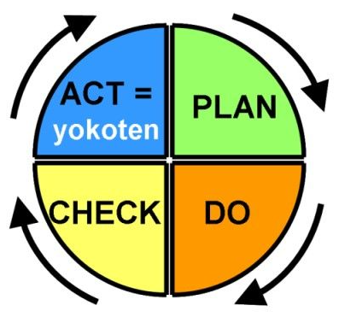
Yokoten
Yokoten is a Japanese term roughly translated to “across every,” and is also referred to as “best practice sharing.” Yokoten is the practice consisting of replicating effective practices laterally from one area to another. It is important to note Yokoten is not the practice of copying or benchmarking exactly; rather Yokoten is the method of copying successful strategies and improving upon their implementation. Effectively practicing and implementing Yokoten will help an organization’s Kaizen efforts by continuously improving processes.

Slide 20
Thank You

